Slide 1
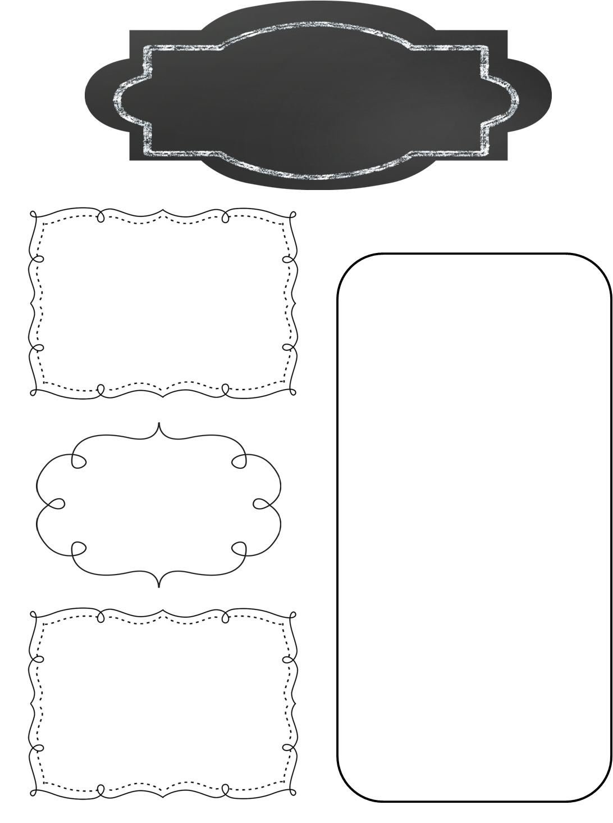
A Peek at Next Week in…
Miss Crites 4th grade
November 13-17
To Know
Thanksgiving break 11/20-11/24
Math
Multi step problems quiz 11/17
Reading/spelling
Biography writing
Spelling test Friday 11/17
Reading log to be signed daily. 20 minutes of reading each night.
Science
Vertebrates/invertebrates Test Monday 11/13
Religion
Class Reminders
Unit 2 test Friday 11/17
Colder temperatures. Be sure to send your child to school with jackets and coats.
Social Studies
Ch. 2 Lesson 2 Quiz 11/13
Midwest quiz 11/13

